Slide 1
Hexagonal Architecture
by Samuel Runggaldier & Peter Unterthurner
Notes:
Today my collegue Samuel and I want to talk about a style of system architecture that we have used successfully in a large project we developed in Konverto. Namely Hexagonal Architecture

Slide 2
Content
How it came to be
Core concepts
Pro and Contra
How to implement it in an existing project
Code example
Notes:
This talk will cover a few points about hexagonal architecture: How it came to be, it‘s core concepts, Pro and Contra, How to implement it into existing projects and finally a Code example, shown by Samuel

Slide 3
How it came to be
Notes:
Lets start with how hexagonal architecture came into existance

Slide 4

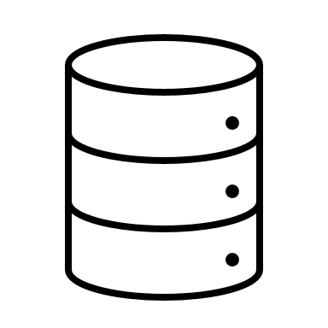
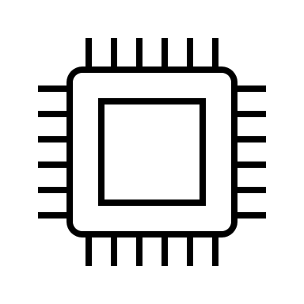
3 Tier Architecture
Presentation Tier
Logic Tier
Data Tier
Notes:
The most common type of software architecture and i guess most of you are familiar with, is the 3 tier architecture. It splits the application into three seperate layers: a presentation tier, which houses the UI to collect and display information to the user. A logic tier, which then processes the gathered information and the data tier which manages and stores the processed data

Slide 5

Domain Driven Design: 4 Tier Architecture
UI
Tier
Application
Tier
Domain
Tier
Infrastructure
Tier
Notes:
Then in 2003, Eric Evans wrote a now famous book, called Domain Driven Design, a concept to bring software logic closer to processes and rules of its intended domain. He proposed among other things a 4 tier architecture, to contain the business logic in its own layer

Slide 6
Benefit of Layered Architecture
Notes:
But why do we care about these architectures?

Slide 7
Benefit of Layered Architecture
Separation of concerns
Notes:
The biggest benefit is the separation of concerns. Each tier is only responsible for its specific functionality. This enhances modularity, maintainability, and scalability and independent development of the application

Slide 8
Benefit of Layered Architecture
Separation of concerns
BUT
Notes:
However, there is still a risk left even using layered architectures.

Slide 9
Benefit of Layered Architecture
Separation of concerns
BUT
No built-in mechanism to detect logic leaks between layers
Notes:
Because there is no built-in mechanism to detect logic leaks between layers. And often it is just a matter of time until one finds traces of infrastructure concerns in the business logic, or parts of business logic mixed in the frontend

Slide 10

Hexagonal Architecture
Alistair Cockburn, 2005
Source: https://de.wikipedia.org/wiki/Alistair_Cockburn#/media/Datei:Alistair_Cockburn_(2007).jpg
Notes:
In 2005 Alistair Cockburn recognized the problem and tried to find a fitting solution

Slide 11
Hexagonal Architecture
Alistair Cockburn, 2005
UI and databases are interchangable external actors
Source: https://de.wikipedia.org/wiki/Alistair_Cockburn#/media/Datei:Alistair_Cockburn_(2007).jpg
Notes:
He saw the UI and databases both as external actors, blind to the internals of the business logic. And that they could be exchanged with any similar component, without the businesslogic needing to change

Slide 12
Hexagonal Architecture
Alistair Cockburn, 2005
UI and databases are interchangable external actors
Application agnostic to the outside
Source: https://de.wikipedia.org/wiki/Alistair_Cockburn#/media/Datei:Alistair_Cockburn_(2007).jpg
Notes:
To achieve this, the application must be completely agnostic to the outside

Slide 13
Hexagonal Architecture
Alistair Cockburn, 2005
UI and databases are interchangable external actors
Application agnostic to the outside
Ports & Adapters
Source: https://de.wikipedia.org/wiki/Alistair_Cockburn#/media/Datei:Alistair_Cockburn_(2007).jpg
Notes:
His solution to this task was to use Ports & Adapters to avoid logic leaks between layers

Slide 14
Core Concepts
Notes:
So let us see how it works in detail

Slide 15
Application
Notes:
This is the center of our architecture, the application, symbolized by a hexagon. What is the secret meaning behind the hexagon? There is none. Cockburn just chose a form that would give the people doing the drawing enough room to insert ports and adapters without being constraint by a one-dimensional layered drwaing

Slide 16
Application
Domain
Notes:
And because hexagonal architecture works so well with domain driven design lets also add a layer for our business domain. Around the hexagon is the „outside“, all the external actors we heard from before, to whom the works of the inside are hidden. Analog to the inside-outside asymmetry exists a left-right asymmetry

Slide 17
DRIVING SIDE
Application
Domain
Notes:
On the left side we have the so called Driving side. This is the side responsible for the application to act

Slide 18
DRIVING SIDE
User Interface
Application
Domain
Notes:
This is the side containing the User Interface

Slide 19



DRIVING SIDE
User Interface
Application
Domain
Notes:
With user input, an API call from another application we can make the application do something

Slide 20
DRIVING SIDE
DRIVEN SIDE
User Interface
Application
Domain
Notes:
On the right side is the driven side. This side reacts when triggered by the application

Slide 21
DRIVING SIDE
DRIVEN SIDE
User Interface
Infrastructure
Application
Domain
Notes:
This is the side where we find all our infrastructure

Slide 22



DRIVING SIDE
DRIVEN SIDE
User Interface
Infrastructure
Application
Domain
Notes:
And has access to databases, files, ecc.
The application itself wants to be agnostic to these external actors and is not concerned from who it gets a request or how the data is fetched or stored. But we still need a way to communicate with the outside

Slide 23
DRIVING SIDE
DRIVEN SIDE
User Interface
Infrastructure
Application
Port
Port
Domain
Notes:
And this communication is done via ports

Slide 24
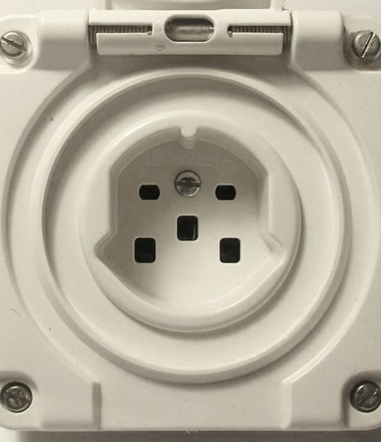
Ports
Source: https://de.wikipedia.org/wiki/Steckdose#/media/Datei:SEV_1011_Typ_25_Steckdose.jpg
Notes:
So what are ports

Slide 25
Ports
Technology-agnostic
Source: https://de.wikipedia.org/wiki/Steckdose#/media/Datei:SEV_1011_Typ_25_Steckdose.jpg
Notes:
A port is a technology-agnostic entrypoint into the application

Slide 26
Ports
Technology-agnostic
Defines interface for communication with the application
Source: https://de.wikipedia.org/wiki/Steckdose#/media/Datei:SEV_1011_Typ_25_Steckdose.jpg
Notes:
it defines the interface on how outside foreign actors can communicate with the Application, regardless of who or what will implement said interface.
Here on the left we see a swiss socket. And we see that it defines exactly the kind of plug that is needed to connect to it, without caring what device wants to plug in

Slide 27
Ports
Technology-agnostic
Defines interface for communication with the application
Dependency Inversion
Source: https://de.wikipedia.org/wiki/Steckdose#/media/Datei:SEV_1011_Typ_25_Steckdose.jpg
Notes:
In software terms this is called dependency inversion and is one of the SOLID principles

Slide 28
Ports
Technology-agnostic
Defines interface for communication with the application
Dependency Inversion
Driving Ports (Inbound) & Driven Ports (Outbound)
Source: https://de.wikipedia.org/wiki/Steckdose#/media/Datei:SEV_1011_Typ_25_Steckdose.jpg
Notes:
In hexagonal architecture we differentiate between Driving Ports and Driven Ports depending on which side they are on

Slide 29
Driving Ports: UseCase
Source: https://de.wikipedia.org/wiki/Steckdose#/media/Datei:SEV_1011_Typ_25_Steckdose.jpg
Notes:
Driving ports, the ports causing the application to act, need a special mention here. They are called UseCases and ideally have certain characteristics

Slide 30
Driving Ports: UseCase
One Objective
Source: https://de.wikipedia.org/wiki/Steckdose#/media/Datei:SEV_1011_Typ_25_Steckdose.jpg
Notes:
They should have one single objective they want to achieve

Slide 31
Driving Ports: UseCase
One Objective
One Method
Source: https://de.wikipedia.org/wiki/Steckdose#/media/Datei:SEV_1011_Typ_25_Steckdose.jpg
Notes:
And building on this they should have only one method that gets called

Slide 32
Driving Ports: UseCase
One Objective
One Method
One Actor
Source: https://de.wikipedia.org/wiki/Steckdose#/media/Datei:SEV_1011_Typ_25_Steckdose.jpg
Notes:
And it should do so for one single actor. In many ways UseCases are similar to user stories, for example: As a user, i want to get all banking records of today such that i can review my spendings

Slide 33
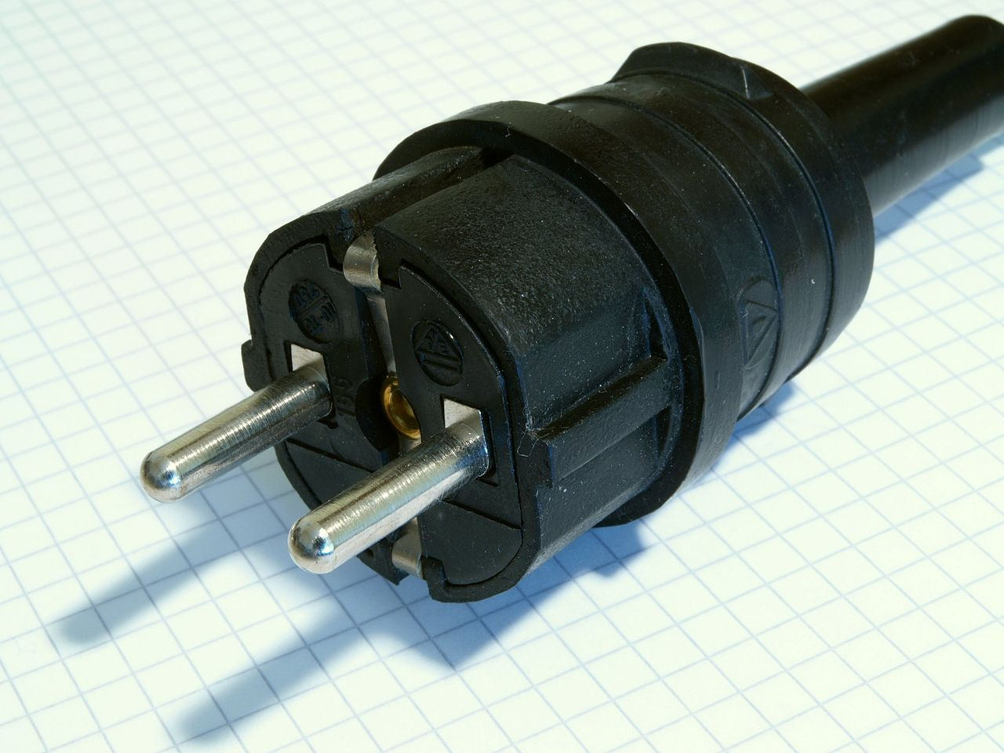
Source: https://de.wikipedia.org/wiki/Schuko#/media/Datei:Schuko_standard.jpg
Notes:
If we think back of the swiss socket. We now have a device we want to plug in. But it looks like this. What do we do?

Slide 34
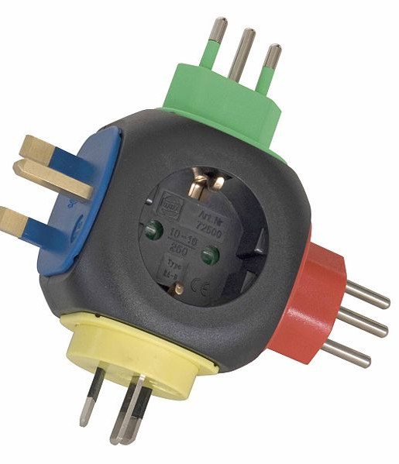
Adapter
Source: https://de.wikipedia.org/wiki/Reisestecker#/media/Datei:72500_Reise-Stecker_komplett_D_RGB.jpg
Notes:
We need an adapter

Slide 35
Adapter
Concrete details
Source: https://de.wikipedia.org/wiki/Reisestecker#/media/Datei:72500_Reise-Stecker_komplett_D_RGB.jpg
Notes:
An adapter contains the concrete details on how to access the port. In software this could be a REST Controller for driving ports or for driven ports a implementation of how to communicate with a SQL database

Slide 36
Adapter
Concrete details
Conversion Layer
Source: https://de.wikipedia.org/wiki/Reisestecker#/media/Datei:72500_Reise-Stecker_komplett_D_RGB.jpg
Notes:
It also acts to translate whatever information flows through it to the form that the Port dictates.

Slide 37
Adapter
Concrete details
Conversion Layer
Exchangable
Source: https://de.wikipedia.org/wiki/Reisestecker#/media/Datei:72500_Reise-Stecker_komplett_D_RGB.jpg
Notes:
And finally it is interchangable with any other adapter that fits the specifications given by the port. So a REST Controller could be swapped with a Scheduler without any changes to the business logic as long as the Ports are satisfied

Slide 38
DRIVING SIDE
DRIVEN SIDE
User Interface
Infrastructure
Application
Port
Port
Adapter
Domain
Adapter
Adapter
Adapter
Notes:
So lets install the adapters in our hexagon

Slide 39
DRIVING SIDE
DRIVEN SIDE
User Interface
Infrastructure
Application
Port
Port
Adapter
Domain
Adapter
Adapter
Adapter
Implements
Uses
Notes:
From left to right, we can see that the driving adapters use the driving ports, for example a REST Controller calling a UseCase Interface

Slide 40
DRIVING SIDE
DRIVEN SIDE
User Interface
Infrastructure
Application
Port
Port
Adapter
Domain
Adapter
Adapter
Adapter
Implements
Uses
Notes:
The concrete implementation of the UseCase lies within the application

Slide 41
DRIVING SIDE
DRIVEN SIDE
User Interface
Infrastructure
Application
Port
Port
Adapter
Domain
Adapter
Adapter
Adapter
Implements
Uses
Notes:
And if needed it can access or store data using the driven ports

Slide 42
DRIVING SIDE
DRIVEN SIDE
User Interface
Infrastructure
Application
Port
Port
Adapter
Domain
Adapter
Adapter
Adapter
Implements
Uses
Notes:
What the driven ports do in detail is implemented in the driven adapter

Slide 43
DRIVING SIDE
DRIVEN SIDE
User Interface
Infrastructure
Application
Port
Port
Adapter
Domain
Adapter
Adapter
Adapter
Notes:
This way the application does not need to know anything about the outside world and operates solely in the business domain.
Maybe to better understand what this means in the software realm, lets see how it looks like with a simple example

Slide 44
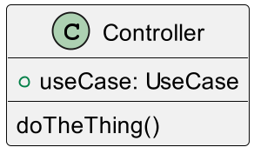
DRIVING SIDE
DRIVEN SIDE
User Interface
Infrastructure
Application
Port
Port
Adapter
Domain
Adapter
Adapter
Adapter
Notes:
We have a Controller acting as a driving adapter

Slide 45
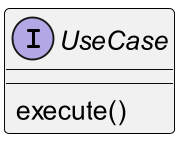
DRIVING SIDE
DRIVEN SIDE
User Interface
Infrastructure
Application
Port
Port
Adapter
Domain
Adapter
Adapter
Adapter
Notes:
Which contains a usecase that it uses once the API is called

Slide 46
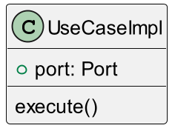
DRIVING SIDE
DRIVEN SIDE
User Interface
Infrastructure
Application
Port
Port
Adapter
Domain
Adapter
Adapter
Adapter
Notes:
The UseCase implementation inside the application can now handle the business logic

Slide 47
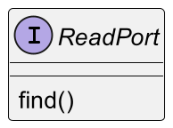
DRIVING SIDE
DRIVEN SIDE
User Interface
Infrastructure
Application
Port
Port
Adapter
Domain
Adapter
Adapter
Adapter
Notes:
It can use driven ports to find the necessary data if needed

Slide 48
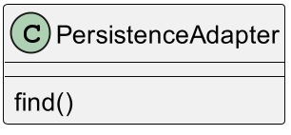
DRIVING SIDE
DRIVEN SIDE
User Interface
Infrastructure
Application
Port
Port
Adapter
Domain
Adapter
Adapter
Adapter
Notes:
And the driven Persistance Adapter which implements the Port, connects to the database, sends a query and translates the retrieved objects back into domain-objects

Slide 49
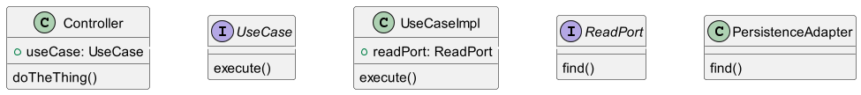
Notes:
So we end with something like this

Slide 50
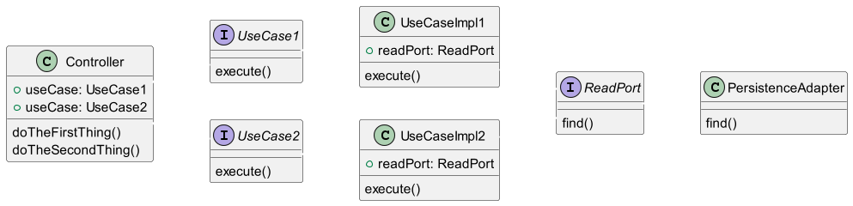
Notes:
An adapter can also contain or implement also more than one port

Slide 51
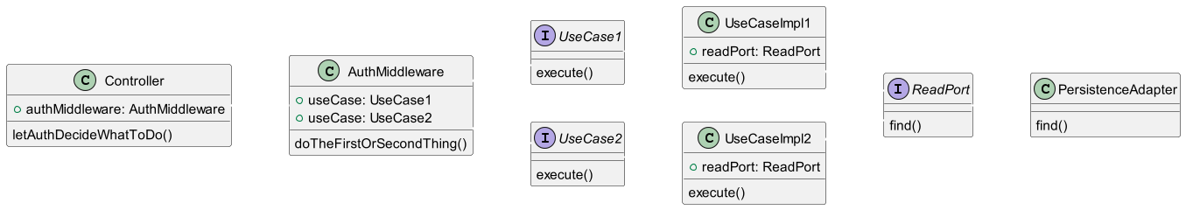
Notes:
Sometimes multiple actors want to do similar things but with different outcomes. Like an admin retrieving data versus a User retrieving data. In this case we could extend the adapter and add a authorisation middleware, which calls different usecases depending on who is logged in

Slide 52
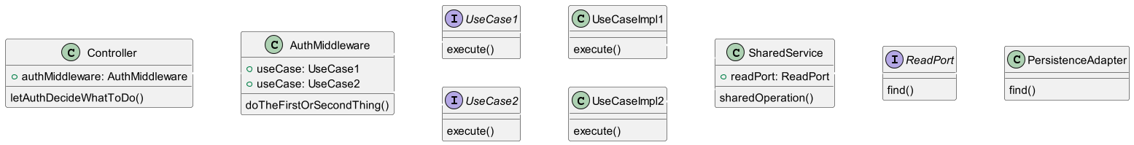
Notes:
And if multiple UseCases share code, because they want to do the same things for the same reason, we can move the shared code into a service. Important to note is that the workflow always goes in one direction. So we have no services calling UseCases, UseCases calling other UseCases or Controllers calling Services. This way we can ensure that the different processes are as isolated from each other as possible and avoid unnecessary dependencies

Slide 53
Pro and Contra
Notes:
So lets talk about the pros and cons of hexagonal archicture

Slide 54
Pro
Notes:
On the pro side

Slide 55
Pro
Scalable
Notes:
The architecture scales extremly well, because of the limitation of dependencies

Slide 56
Pro
Scalable
Flexible
Notes:
We have very high flexibility. If a new tenant wants us to retrieve the data from a file instead of the database or the UI gets replaced, we simple have to exchange the adapters, without touching the business logic

Slide 57
Pro
Scalable
Flexible
Testable
Notes:
When adding mocks or stubs to the ports, we can test our whole business logic. The tests also withstand internal refactorings as long as the businesslogic stays the same

Slide 58
Contra
Notes:
So what are arguments against hexagonal architecture?

Slide 59
Contra
Learning Curve
Notes:
The first most obvious one is the learning curve. Developers might need some time to adjust to the principles dictated by the architecture

Slide 60
Contra
Learning Curve
Increased Complexity
Notes:
Secondly we have additional abstractions, more components, more object mapping, which can make the project more complex than with a simpler architecture

Slide 61
Contra
Learning Curve
Increased Complexity
Bigger Overhead for small projects
Notes:
Which in turn leads to more overhead, which might make it too much to deal with for small projects

Slide 62
BUT
Notes:
But on the note of small projects

Slide 63
BUT
Will the project stay small?
Notes:
Will it stay small? Or will there be more and more requirements flooding in until the project is not so small anymore

Slide 64
BUT
Will the project stay small?
There will be no Jira Ticket „Refactoring Architecture“
Notes:
Most of the time we dont get a chance to restructure the project once we decided to take a certain road

Slide 65
How to implement it in an existing project?
Notes:
But in the case that we want to do the switch, what should we do?

Slide 66

JUST DO IT
Notes:
We just do it

Slide 67
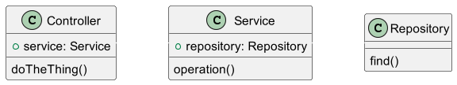
Notes:
Take this example of a common architecture. We have a Controller that calls a service which accesses directly a repository. Now immagine a new requirements come in

Slide 68
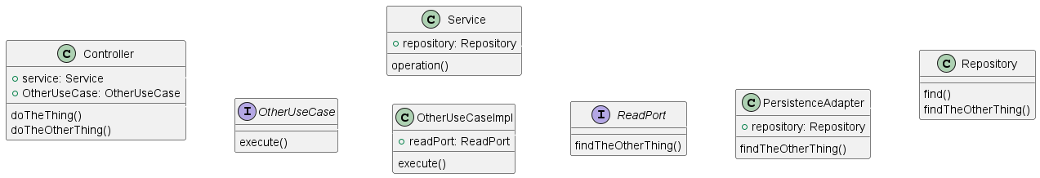
Notes:
The best way in my opinion to switch is to just start implementing the new requirements using hexagonal architecure

Slide 69
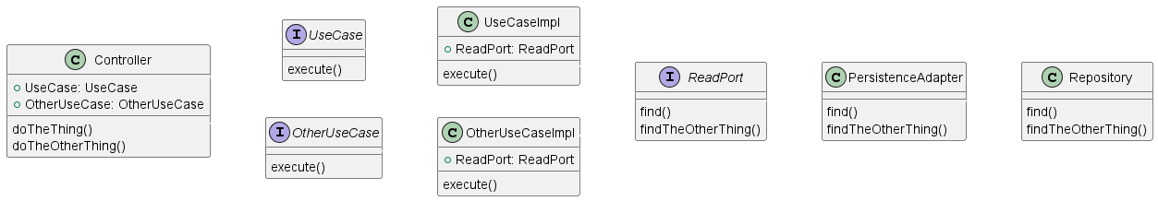
Notes:
And whenever we have to touch existing code, we refactor the bit we are working on. And over time, more and more of the code will get refactored until we reach a point were we migrated the architecture succesfully

Slide 70
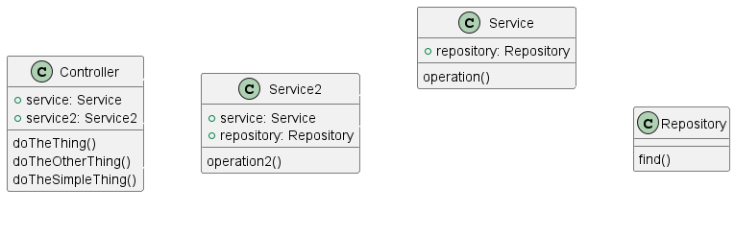

Slide 71
Code Example
Notes:
Okay, enough theory, my collegue Samuel will now show you how a real world application looks like using hexagonal architecture

